Slide 1
FHIR for Executives
Lloyd McKenzie
April 27, 2017

Slide 2
This presentation
Is licensed for use under the Creative Commons, specifically:
Creative Commons Attribution 3.0 Unported License
(Do with it as you wish, so long as you give credit)
Can be downloaded here:
http://gforge.hl7.org/svn/fhir/trunk/presentations/2017-04%20FHIR%20North/FHIR%20for%20Executives.pptx
Use “anonymous” and email address to logon

Slide 3

Who am I?
Name: Lloyd McKenzie
Company: Gevity
Background:
One of FHIR’s 3 initial editors
Co-chair FMG & FHIR Infrastructure
Co-chair HL7 Modeling & Methodology
Heavily involved in HL7 and healthcare exchange for last 16 years (v2, v3, CDA, etc.)
lmckenzie@gevityinc.com

Slide 4
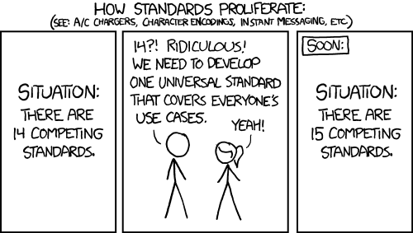
http://xkcd.com/927

Slide 5
Complexity Model
Snomed
HL7 V3
openEHR
WS
CDA
Difficulty (log)
XML
HL7 v2
How?
HTTP / HTML
Text
Semantic Depth

Slide 6
The acronym
F – Fast (to design & to implement)
Relative – No technology can make integration as fast as we’d like
H – Healthcare
That’s why we’re here
I – Interoperable
Ditto
R – Resources
Building blocks – more on these to follow

Slide 7
FHIR – Key differences
Focus on Implementers
Target support for common scenarios
Leverage cross-industry web technologies
Require human readability as base level of interoperability
Make content freely available
Support multiple paradigms & architectures
Demonstrate best practice governance
Notes:
We don’t actually have a formal manifesto, but these are the principles we adhere to.

Slide 8
Example – ISO AD type
isNotOrdered, updateMode, flavorId, nullFlavor, controlAct root & extension, validTime low and high, useable period (GTS – no room on the slide), use
home, primary home, vacation home, workplace, direct, public, bad, physical, postal, temporary, alphabetic, ideographic, syllabic, search, soundex, phonetic
0..* parts, each with:
value, code, code system, code system name, code system version, language, type:
address line, additional locator, unit identifier, unit designator, delivery address line, delivery installation type, delivery installation area, delivery installation qualifier, delivery mode, delivery mode identifier, street address line, building number, building number numeric, building number suffix, street name, street name base, street type, direction, intersection, care of, census tract, country, county or parish, municipality, delimiter, post box, precinct, state or province, postal code, delivery point identifier
Notes:
How many of your systems have user interfaces that support even ¼ of this?

Slide 9
Example – FHIR Address
isNotOrdered, updateMode, flavorId, nullFlavor, controlAct root & extension, validTime low and high, useable period (low, high) (GTS – no room on the slide), use
home, primary home, vacation home, workplace, direct, public, bad, physicalvisit, postal, temporary, alphabetic, ideographic, syllabic, search, soundex, phonetic, old
0..* parts, each with:text
value, code, code system, code system name, code system version, language, type:
address line, additional locator, unit identifier, unit designator, delivery address line, delivery installation type, delivery installation area, delivery installation qualifier, delivery mode, delivery mode identifier, street address line, building number, building number numeric, building number suffix, street name, street name base, street type, direction, intersection, care of, census tract, country, county or parish, municipalitycity, delimiter, post box, precinct, state or province, postalCode, delivery point identifier
Notes:
This is what happens when you apply the 80% . . .

Slide 10
FHIR & Cost of Integration
These factors will drive down the cost of integration and interoperability
Easier to Develop
Easier to Troubleshoot
Easier to Leverage in production
More people to do the work (less expensive consultants)
Competing approaches will have to match the cost, or disappear – effect is already being felt

Slide 11
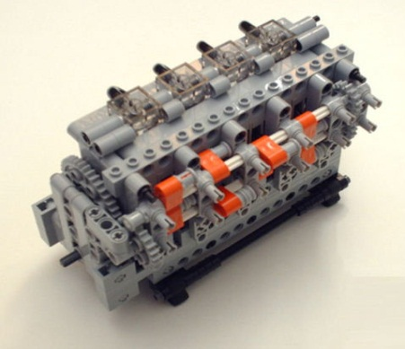
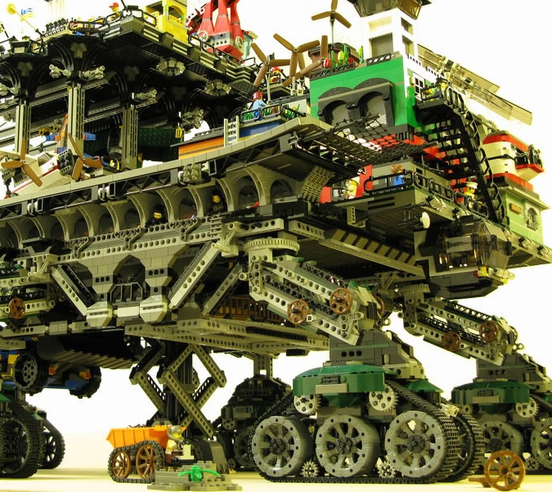

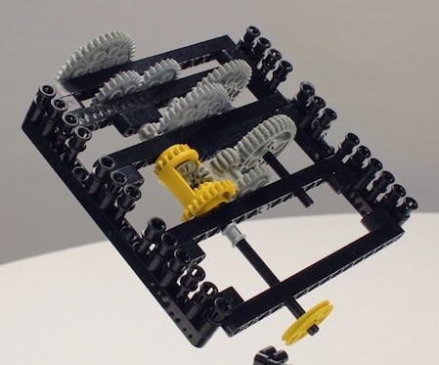
FHIR solutions
Resources
Extensions
Solution
+
=
Notes:
Resources are building blocks, but useful in their own right
Extensions supplement what resource doesn’t cover
Solutions can be simple or complex

Slide 12


Resources
“Resources” are:
Small logically discrete units of exchange
Defined behavior and meaning
Known identity / location
Smallest unit of transaction
“of interest” to healthcare
V2: Sort of like Segments
V3: Sort of like CMETs

Slide 13
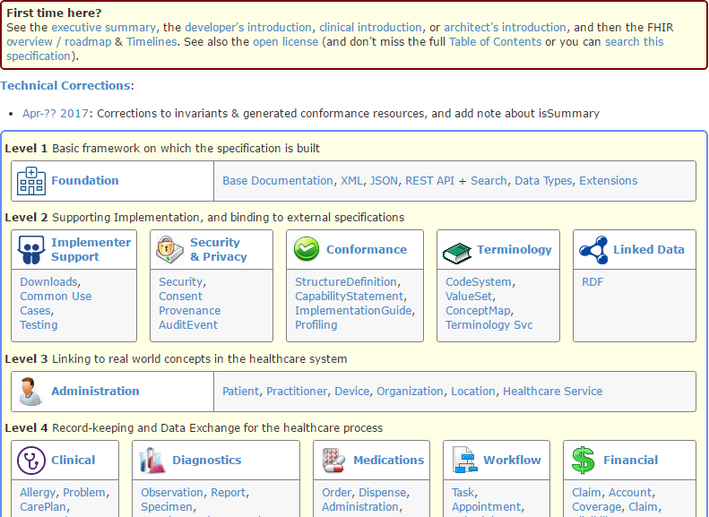
(FHIR home)
hl7.org/fhir
Notes:
Published as HTML
Published using validation process that performs consistency checks – like a software build
Really shouldn’t require much guidance to read, but a few things to call out
Objective of spec is developer can skim and decide in < day

Slide 14
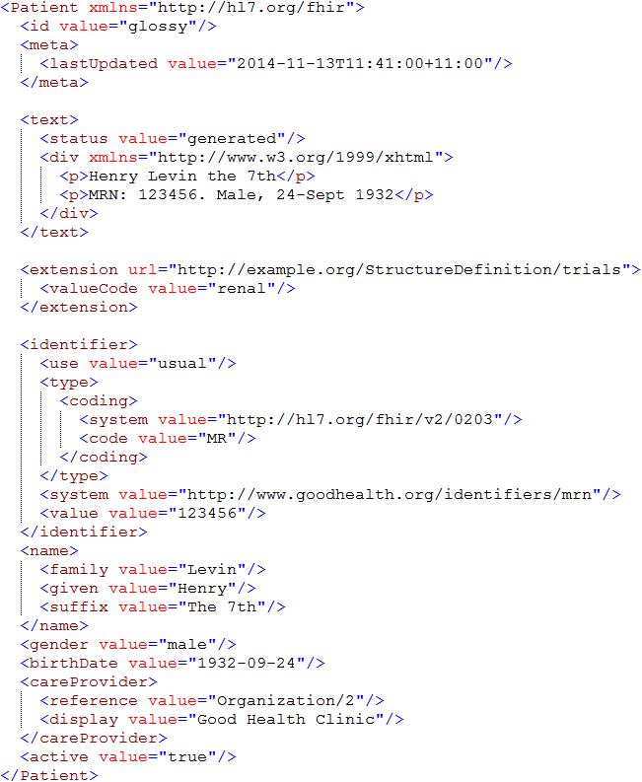
Identity & Metadata
Human Readable Summary
Extension with reference to its definition
Standard Data Content:
MRN
Name
Gender
Date of Birth
Provider

Slide 15
FHIR Timeline (planned)
First Draft
1st
STU
~ 2nd
STU
~ 3rd
STU
R4
. . .
2011
2012
2013
2014
2015
2016
2017
2018
2019
2020
Notes:
Note that dates are subject to change based on resources and the standards process

Slide 16
Maturity levels
Intended to indicate level of stability
FMM1 – Resource is “done”, no build warnings
FMM2 – Tested at approved Connectathon
FMM3 – Passes QA, has passed ballot
FMM4* – Tested across scope, published, prototype implementation
FMM5* – 5 distinct production implementations, 2+ multiple countries
Normative – WG & community agree

Slide 17
FHIR as a replacement
FHIR has the potential to supplant HL7 v3, CDA and even v2
However
It’s probably not going to do so right away
HL7 will support existing product lines so long as the market needs them
Notes:
Few will throw away their investment in older standards to use FHIR until
The specification has a good track record
It’s clear the new thing provides significant benefits

Slide 18
FHIR is:
Technology
Spec, reference implementations, test tools
Community
http://chat.fhir.org, forums, connectathons, work groups

Slide 19
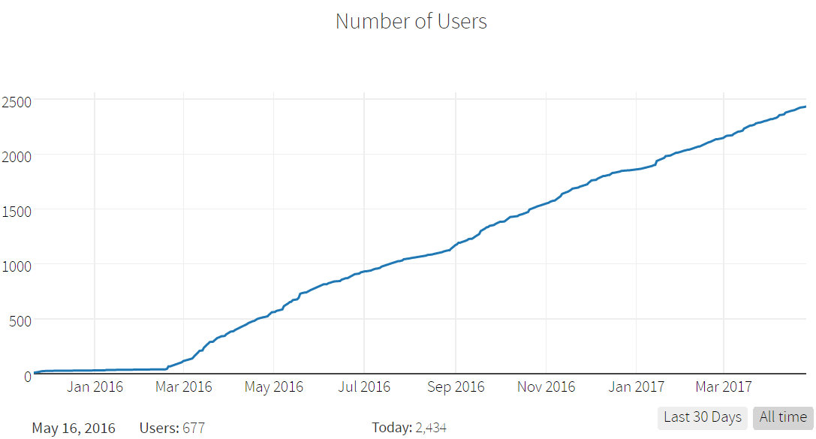
chat.fhir.org growth

Slide 20
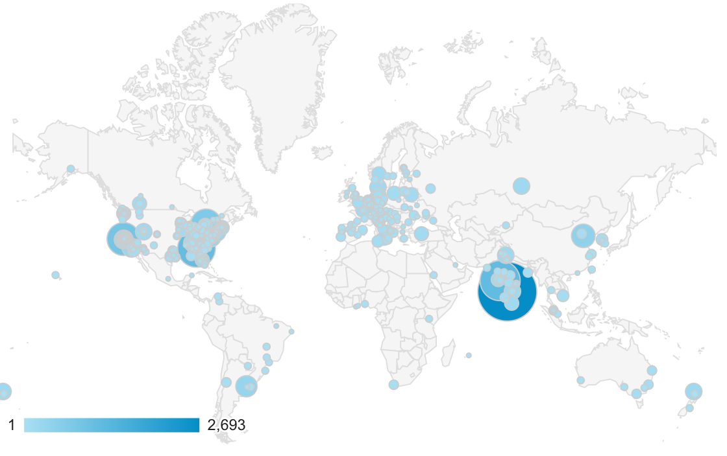
Who’s using FHIR?
Systems accessing HAPI server in 2015
Notes:
Jan->mid Nov. 2015 – unique systems accessing the HAPI test server

Slide 21

FHIR Adopters
SDOs – IHE, DICOM, W3C
Governments – US, UK Lithuania
EHR vendors – Allscripts, Cerner, Epic, etc.
E.g. Argonaut
Care delivery – Mayo, Intermountain, UHN, VA
Small vendors, start-ups
Lots & lots – all over the world

Slide 22
Early Adopter takeaways
Broad international interest
Wide range of engagement
National initiatives
Care provider organizations
Small vendors/entrepreneurs
Mixture of green-field and upgrading existing systems
All with short times to production
Baby steps to full commitment

Slide 23
Additional insights
Furore Executive Videos series
http://fhir.furore.com/Education#videos
FHIR Applications Roundtable (Jul 2016)
https://www.pathlms.com/hl7/courses/3152

Slide 24
Risks with FHIR
FHIR is new
Be ready to migrate
Caution for mission critical applications
FHIR is cool
Be realistic about what’s achievable
Work with others (HL7, IHE, etc.) to build profiles
FHIR is coming
At minimum, monitor
Consider whether to pilot to build experience
Notes:
Still in STU
No backward compatibility guarantee
Some content missing
Limited production experience
Change is likely
Near the top of the hype curve
FHIR won’t fix all interoperability issues
Consensus, terminology, legacy burdens still exist
FHIR provides a framework and platform
Hard work still in profiling
Mitigations
Be realistic about what’s achievable
Work with others (HL7, IHE, industry groups) on the profiles you’ll need
Momentum is high – it will disrupt the health IT environment
Strong interest from regulators (e.g. ONC)
Strong interest from major vendors
Hitting at all points in the market chain
Plan what you could do, decide conditions for entry

Slide 25
Final message
FHIR
is easier and cheaper
is being implemented now
is likely to significantly impact Health IT
Decide how you want it to impact your organization

Slide 26

Questions?
http://hl7.org/fhir lmckenzie@gevityinc.com

